Slide 1
Unit II: Fundamentals of Java Programming

Slide 2
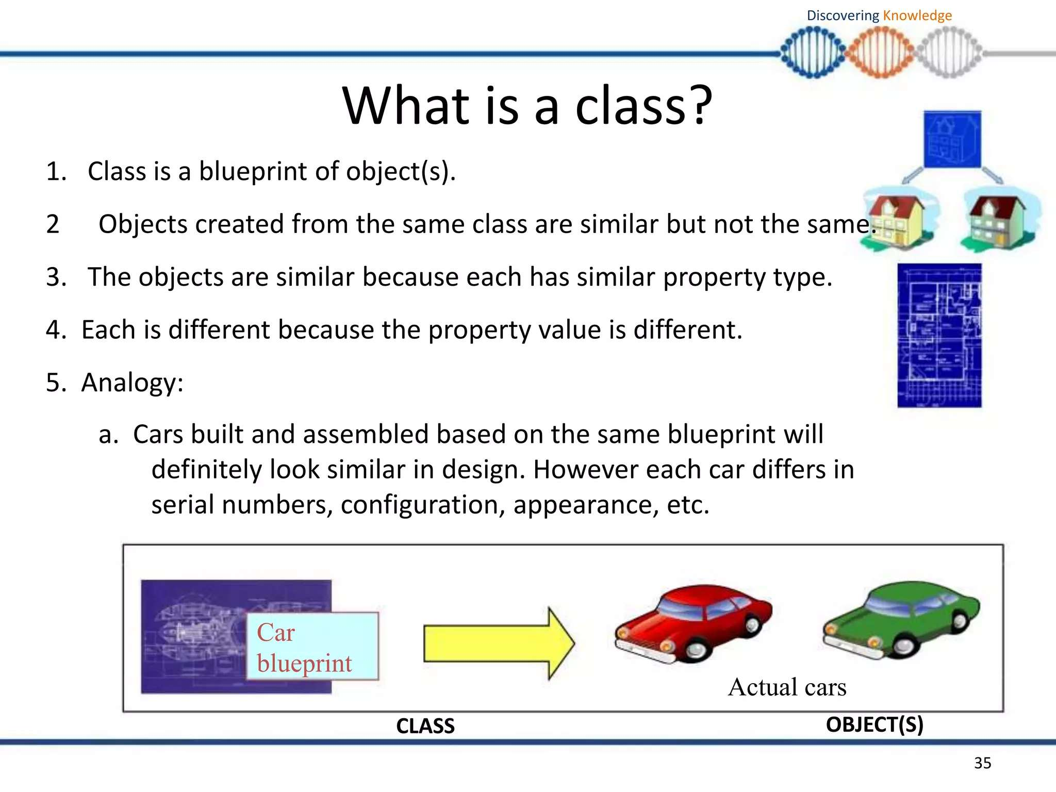

Slide 3
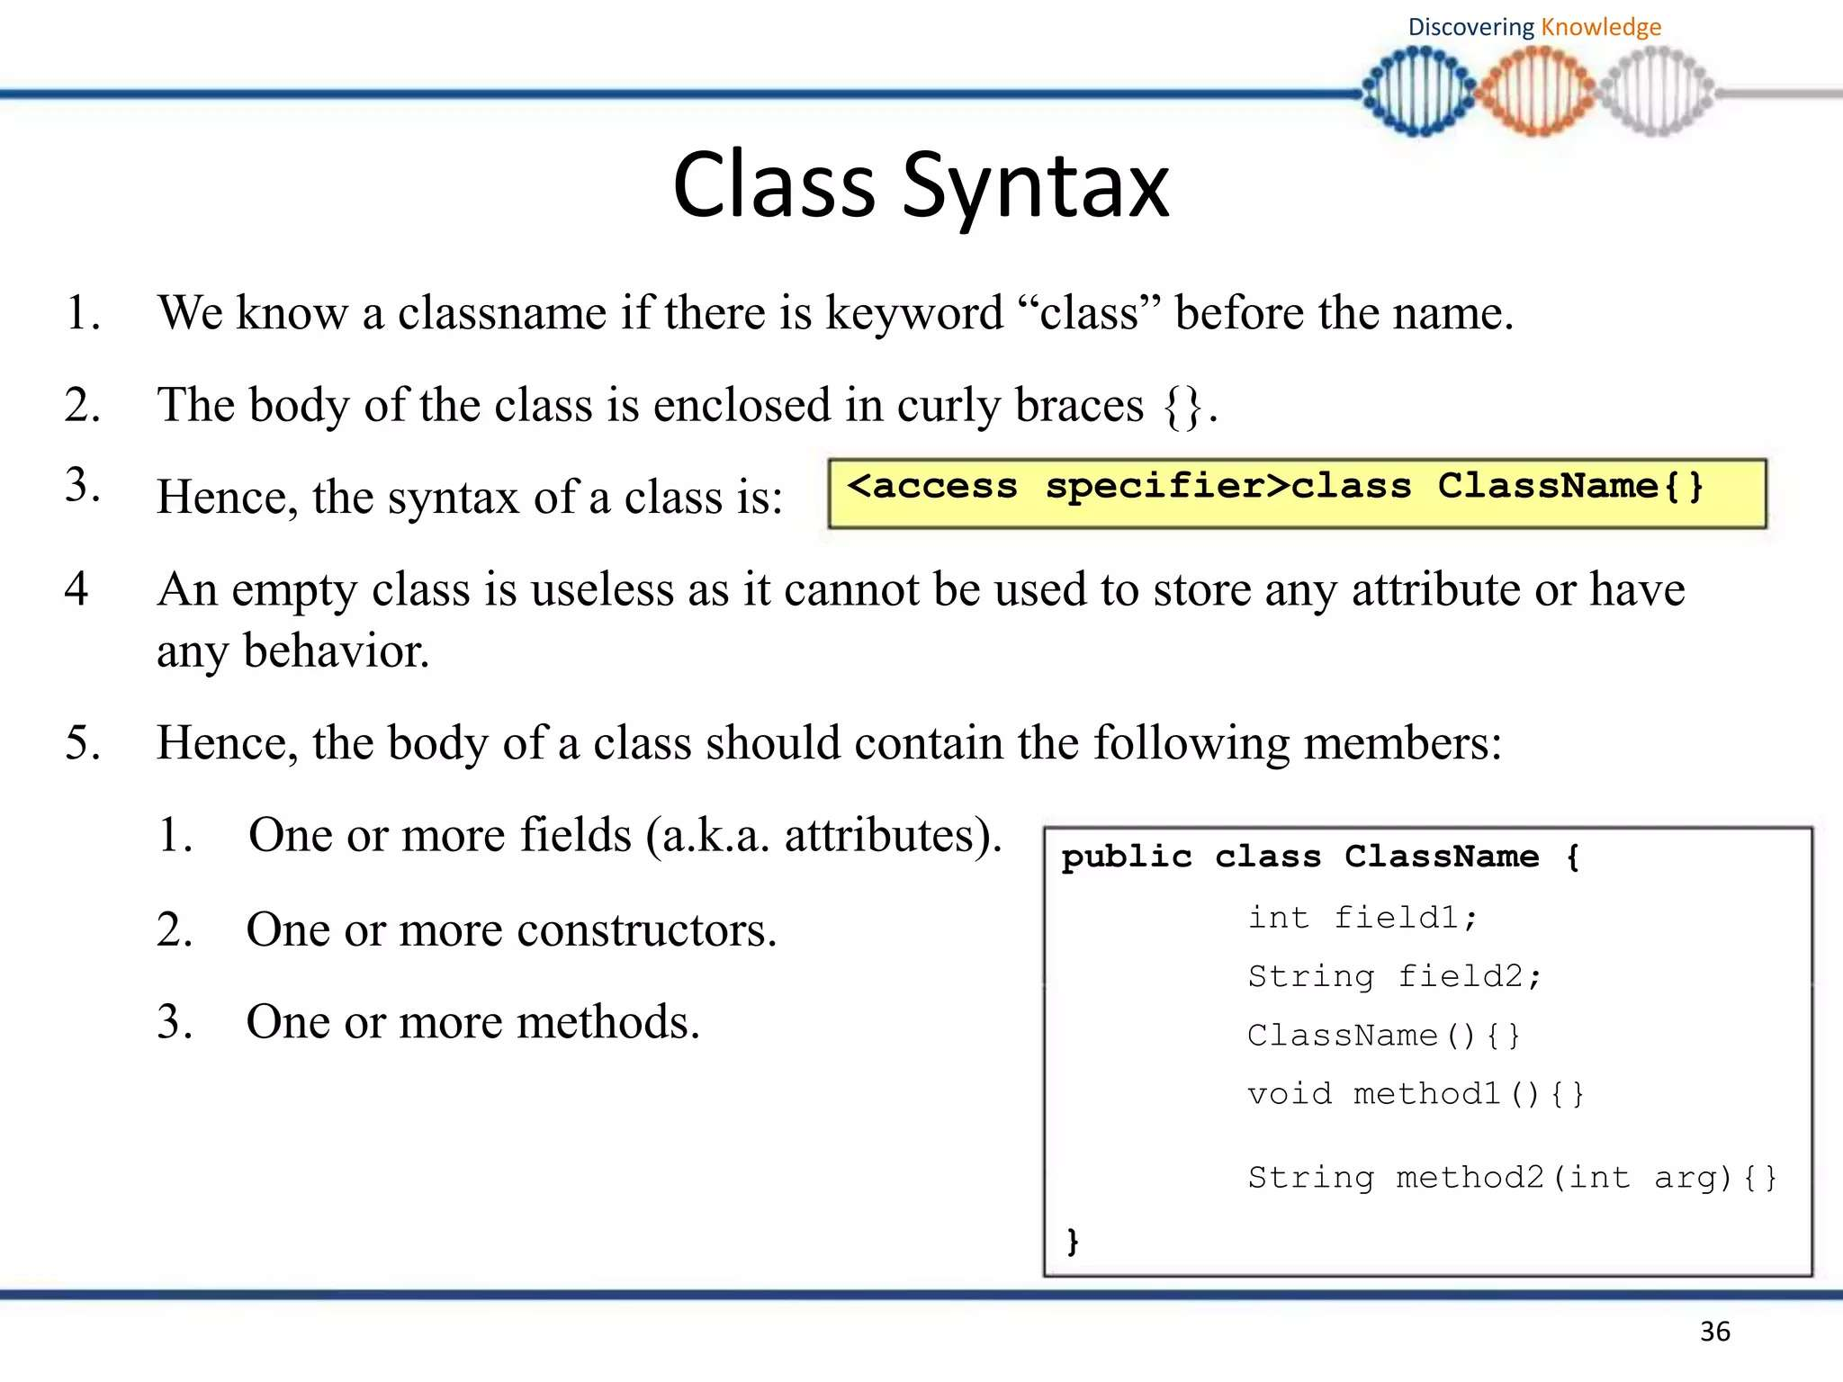

Slide 4
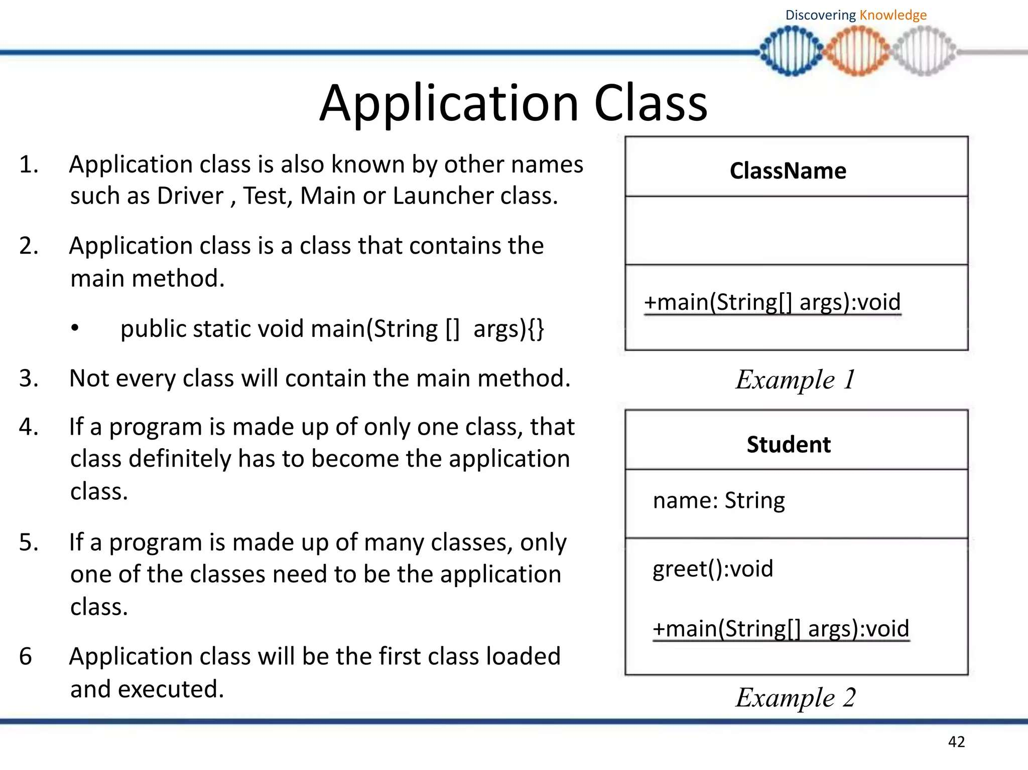

Slide 5
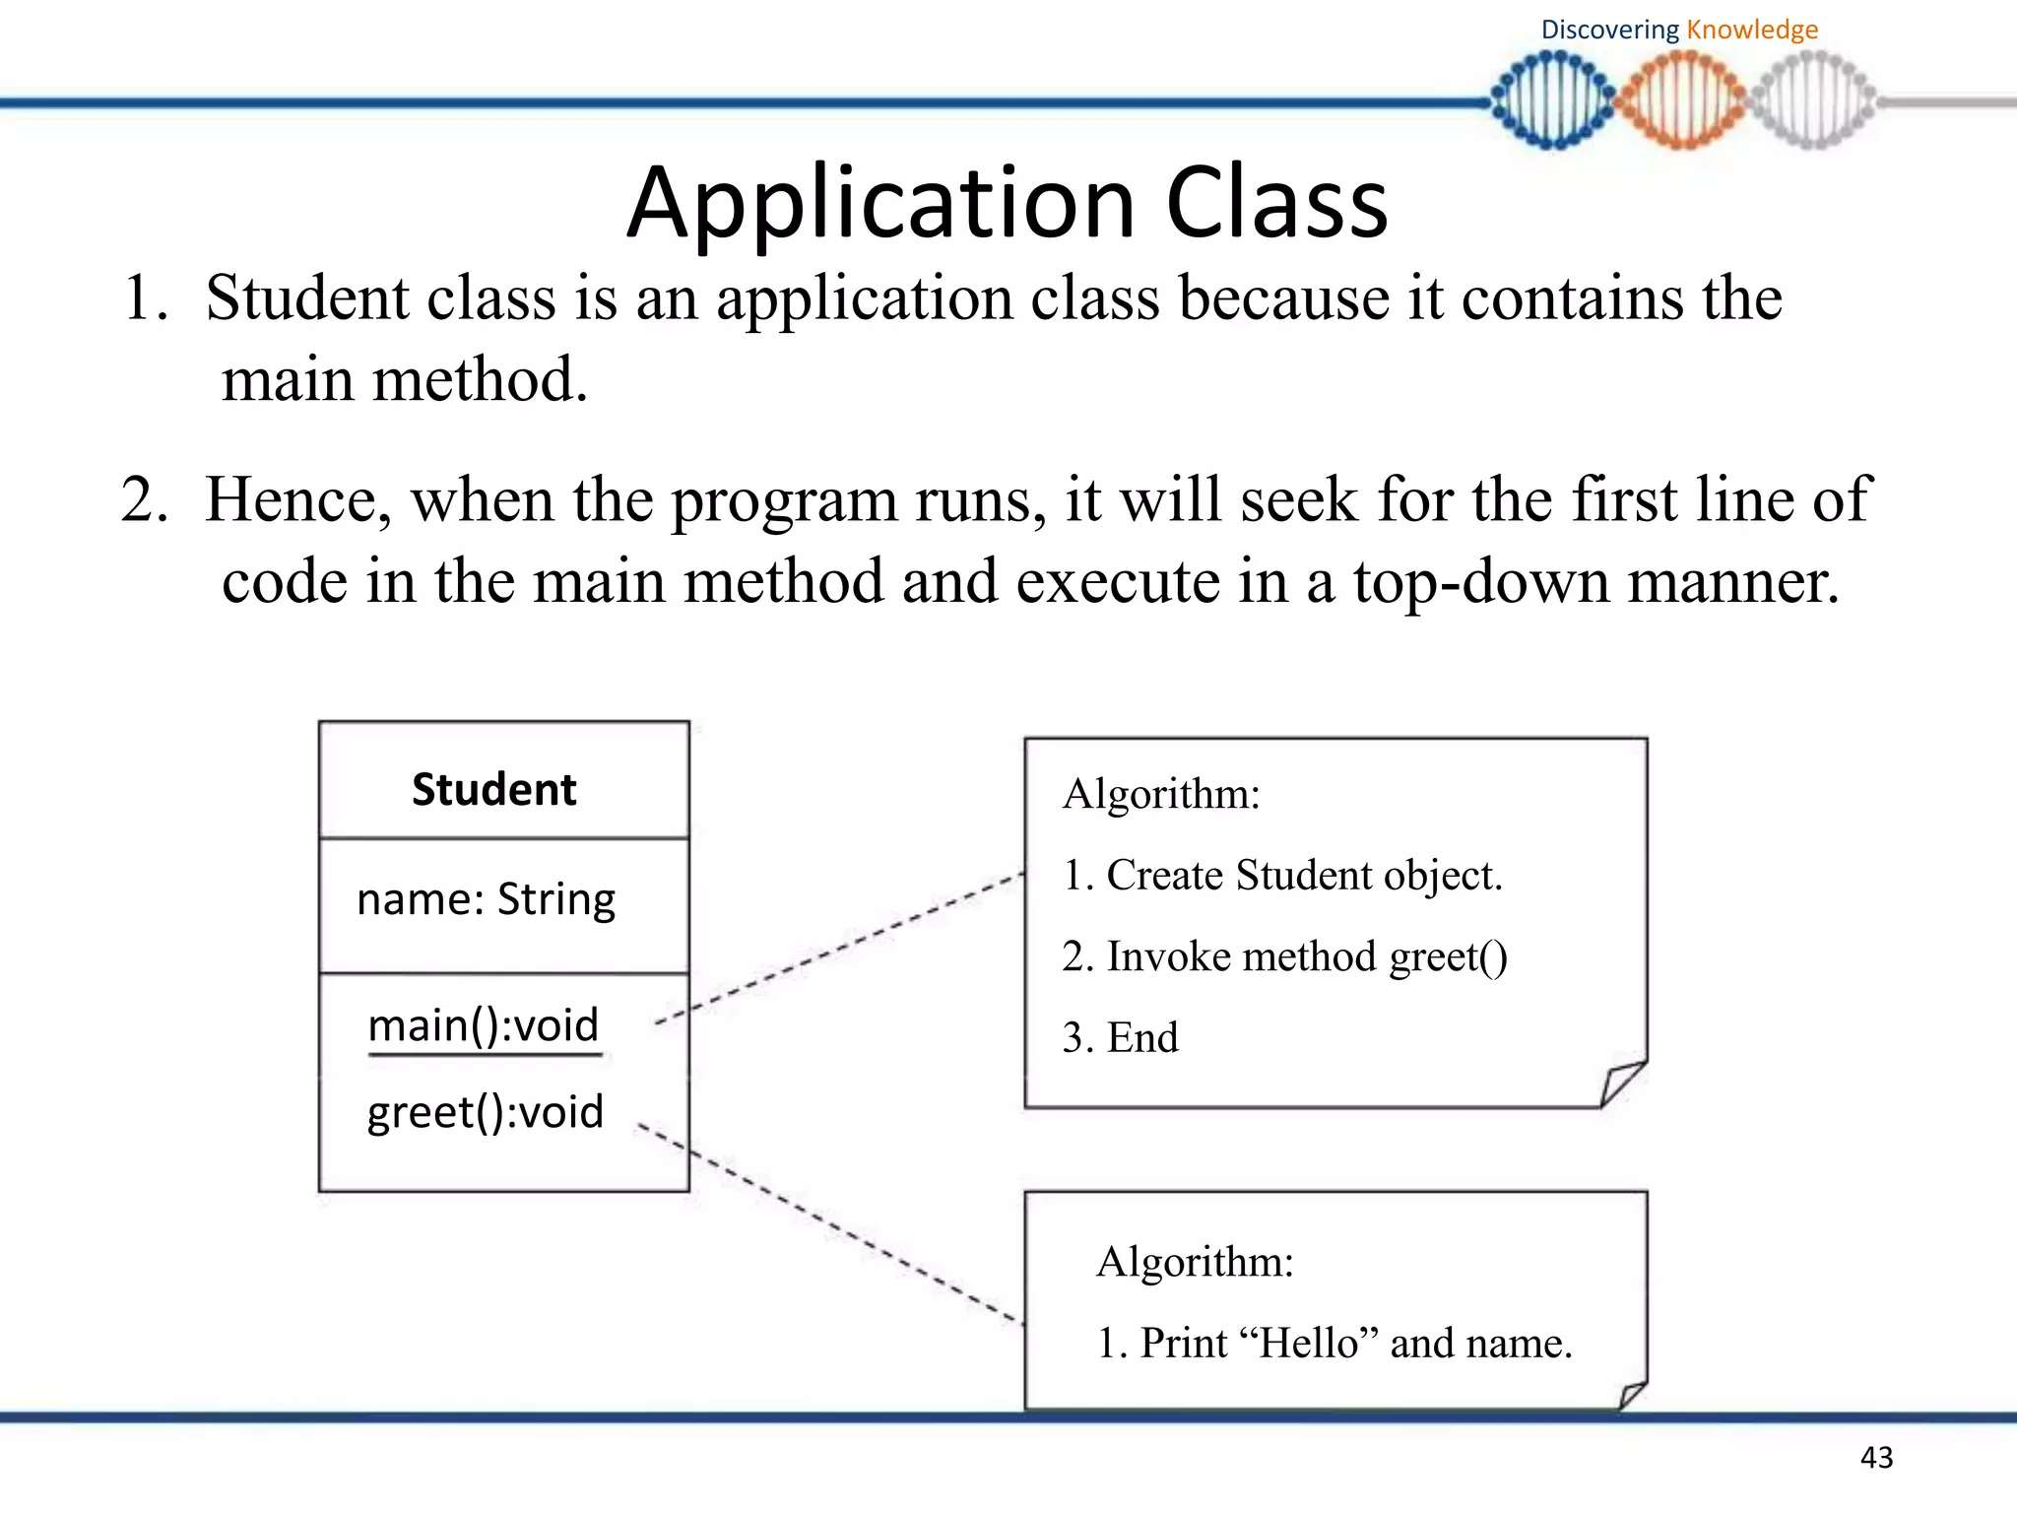

Slide 6
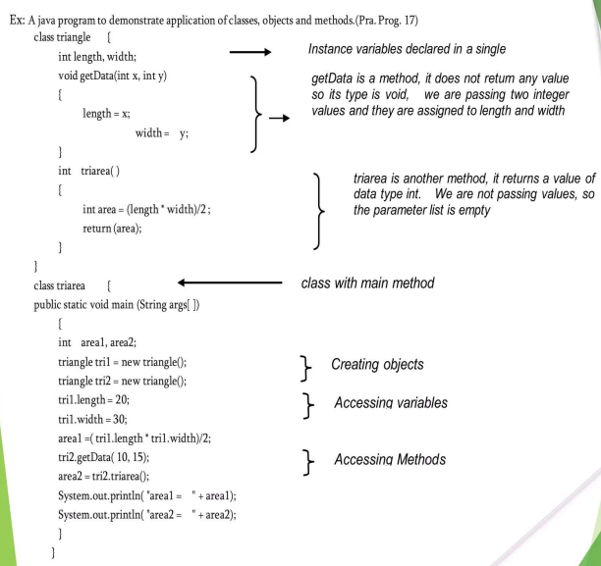

Slide 7
Types of Variable
There are three types of variables in java:
1) Local Variable
A variable which is declared inside the method is called local variable.
2) Instance Variable
A variable which is declared inside the class but outside the method, is called instance variable . It is not declared as static.
3) Static variable
A variable that is declared as static is called static variable. It cannot be local.

Slide 8
Example to understand the types of variables in java
class A
{
int data=50; //instance variable
static int m=100; //static variable
void method( )
{
int n=90; //local variable
}
}

Slide 9
Constants in Java
A constant is a variable which cannot have its value changed after declaration.
It uses the 'final' keyword.
Syntax:
access-modifier final dataType variableName = value;
public final float pi=3.14;

Slide 10
Java String
string is basically an object that represents sequence of char values.
An array of characters works same as java string.
For example:
1. char[] ch={'j','a','v','a','t','p','o','i','n','t'};
2. String s=new String(ch);
Java String class provides a lot of methods to perform operations on string such as compare(), concat(), equals(), split(), length(), replace(), compareTo(), intern(), substring() etc.
There are two ways to create String object:
1. By string literal
2. By new keyword

Slide 11
Java String
String Literal
Java String literal is created by using double quotes. For Example:
String s="welcome";
Each time you create a string literal, the JVM checks the string constant pool first.
If the string already exists in the pool, a reference to the pooled instance is returned.
If string doesn't exist in the pool, a new string instance is created and placed in the pool.
For example:
1. String s1="Welcome";
2. String s2="Welcome"; //will not create new instance

Slide 12
Java String
By new keyword
String s=new String("Welcome");
In such case, JVM will create a new string object in normal (non pool) heap memory and the
literal "Welcome" will be placed in the string constant pool.
The variable s will refer to the object in heap (non pool).
public class StringExample
{
public static void main(String args[])
{
String s1="java"; //creating string by java string literal
char ch[]={'s','t','r','i','n','g','s'};
String s2=new String(ch); //converting char array to string
String s3=new String("example"); //creating java string by new keyword
System.out.println(s1);
System.out.println(s2);
System.out.println(s3);
}}

Slide 13
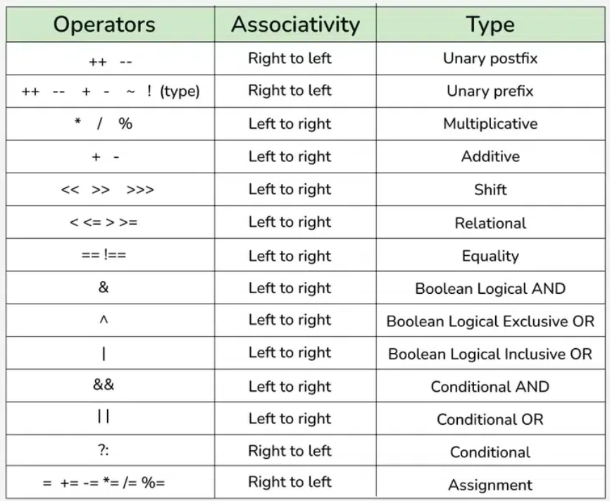
Operators in Java
o Unary Operator
o Arithmetic Operator
o shift Operator
o Relational Operator
o Bitwise Operator
o Logical Operator
o Ternary Operator
o Assignment Operator

Slide 14
Java Type conversion and Type casting
Widening or Automatic Type Conversion:
Takes place when two data types are automatically converted. This happens when:
The two data types are compatible.
When we assign value of a smaller data type to a bigger data type.
In java the numeric data types are compatible with each other but no automatic conversion is supported from numeric type to char or boolean
int x=30;
float y;
y=x; // y==30.000000.

Slide 15
Java Type conversion and Type casting
Narrowing or Explicit Type Casting:
If we want to assign a value of larger data type to a smaller data type we perform explicit type casting or narrowing.
This is useful for incompatible data types where automatic conversion cannot be done.
Here, target-type specifies the desired type to convert the specified value to.
float x;
int y;
y=(int)x;

Slide 16
Enum in java
Enum in java is a data type that contains fixed set of constants
It can be used for days of the week (SUNDAY, MONDAY, TUESDAY, WEDNESDAY, THURSDAY, FRIDAY, SATURDAY) , directions (NORTH, SOUTH, EAST, WEST) etc.
The java enum constants are static and final implicitly.
Java Enums can be thought of as classes that have fixed set of constants.

Slide 17
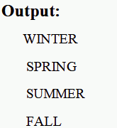
Enum in java
Simple example of java enum
class EnumExample1
{
public enum Season { WINTER, SPRING, SUMMER, FALL }
public static void main(String[] args)
{
for (Season s : Season.values())
System.out.println(s);
}
}

Slide 18
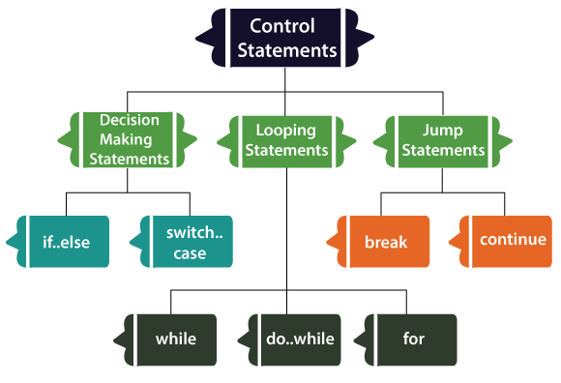
Control Flow Statements

Slide 19
Declaring Arrays
Declaring Array Variables:
datatype arrayRefVar[ ];
or
dataType[ ] arrayRefVar;
int[ ] myList={1,2,3,4,5};
or
int myList[ ]={1,2,3,4,5};
datatype arrayRefVar = new dataType[arraySize];
int myList=new int[ ]{1,2,3,4,5}
Creating Arrays: //allocating memory to array

Slide 20
Processing Arrays
For Loop:
for (int i = 0; i < myList.length; i++)
{
System.out.println(myList[i] + " ");
}
Or
for (int element: myList)
{
System.out.println(element);
}

Slide 21
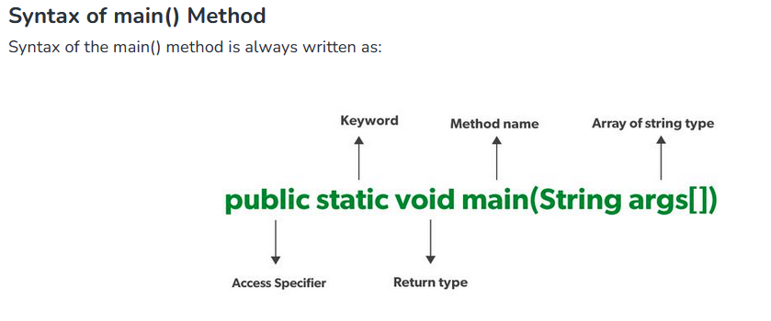
Java main() Method – public static void main(String[] args)
Java’s main() method is the starting point from where the JVM starts the execution of a Java program.
1. Public
It is an Access modifier, which specifies from where and who can access the method. Making the main() method public makes it globally available. It is made public so that JVM can invoke it from outside the class as it is not present in the current class.
If the main method is not public, it’s access is restricted.

Slide 22
Java main() Method – public static void main(String[] args)
2. Static
It is a keyword that is when associated with a method, making it a class-related method. The main() method is static so that JVM can invoke it without instantiating the class. This also saves the unnecessary wastage of memory which would have been used by the object declared only for calling the main() method by the JVM.
If you try to run Java code where main is not static, you will get an error.

Slide 23
Java main() Method – public static void main(String[] args)
3. Void
It is a keyword and is used to specify that a method doesn’t return anything. As the main() method doesn’t return anything, its return type is void. As soon as the main() method terminates, the Java program terminates too. Hence, it doesn’t make any sense to return from the main() method as JVM can’t do anything with its return value of it.
If main method is not void, we will get an error.

Slide 24
Java main() Method – public static void main(String[] args)
4. main
It is the name of the Java main method. It is the identifier that the JVM looks for as the starting point of the Java program. It’s not a keyword.
If we change the name while initiating main method, we will get an error.

Slide 25
Java main() Method – public static void main(String[] args)
5. String[] args
It stores Java command-line arguments and is an array of type java.lang.String class. Here, the name of the String array is args but it is not fixed and the user can use any name in place of it.

Slide 26
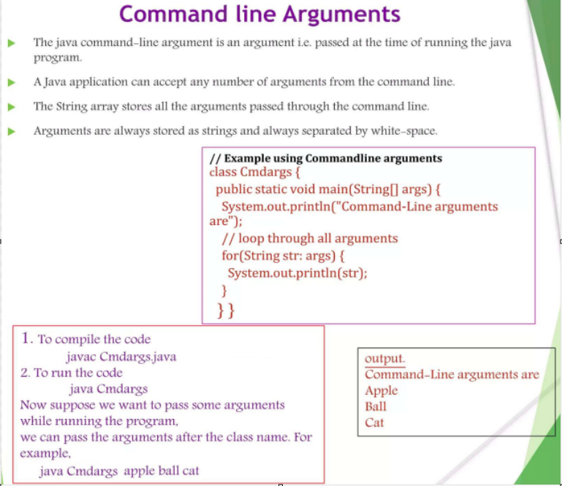

Slide 27
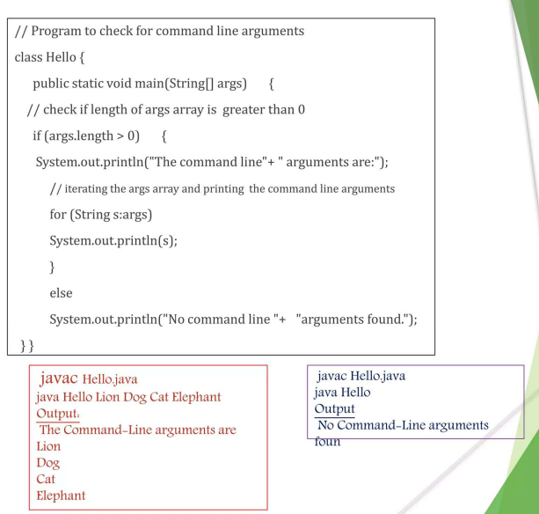

Slide 28
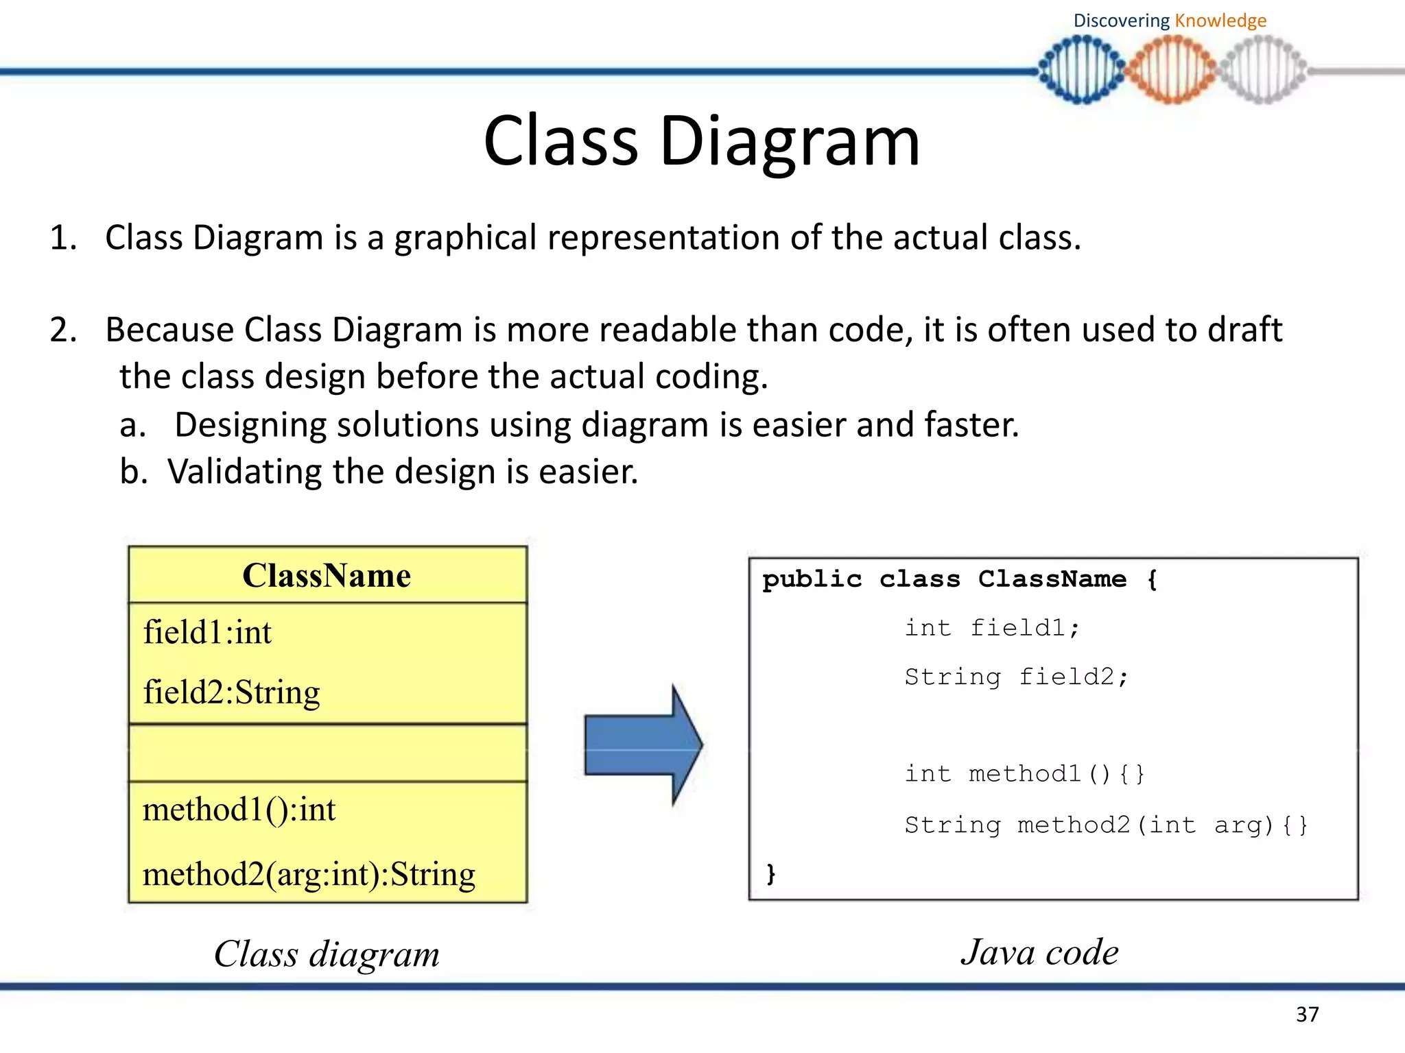

Slide 29
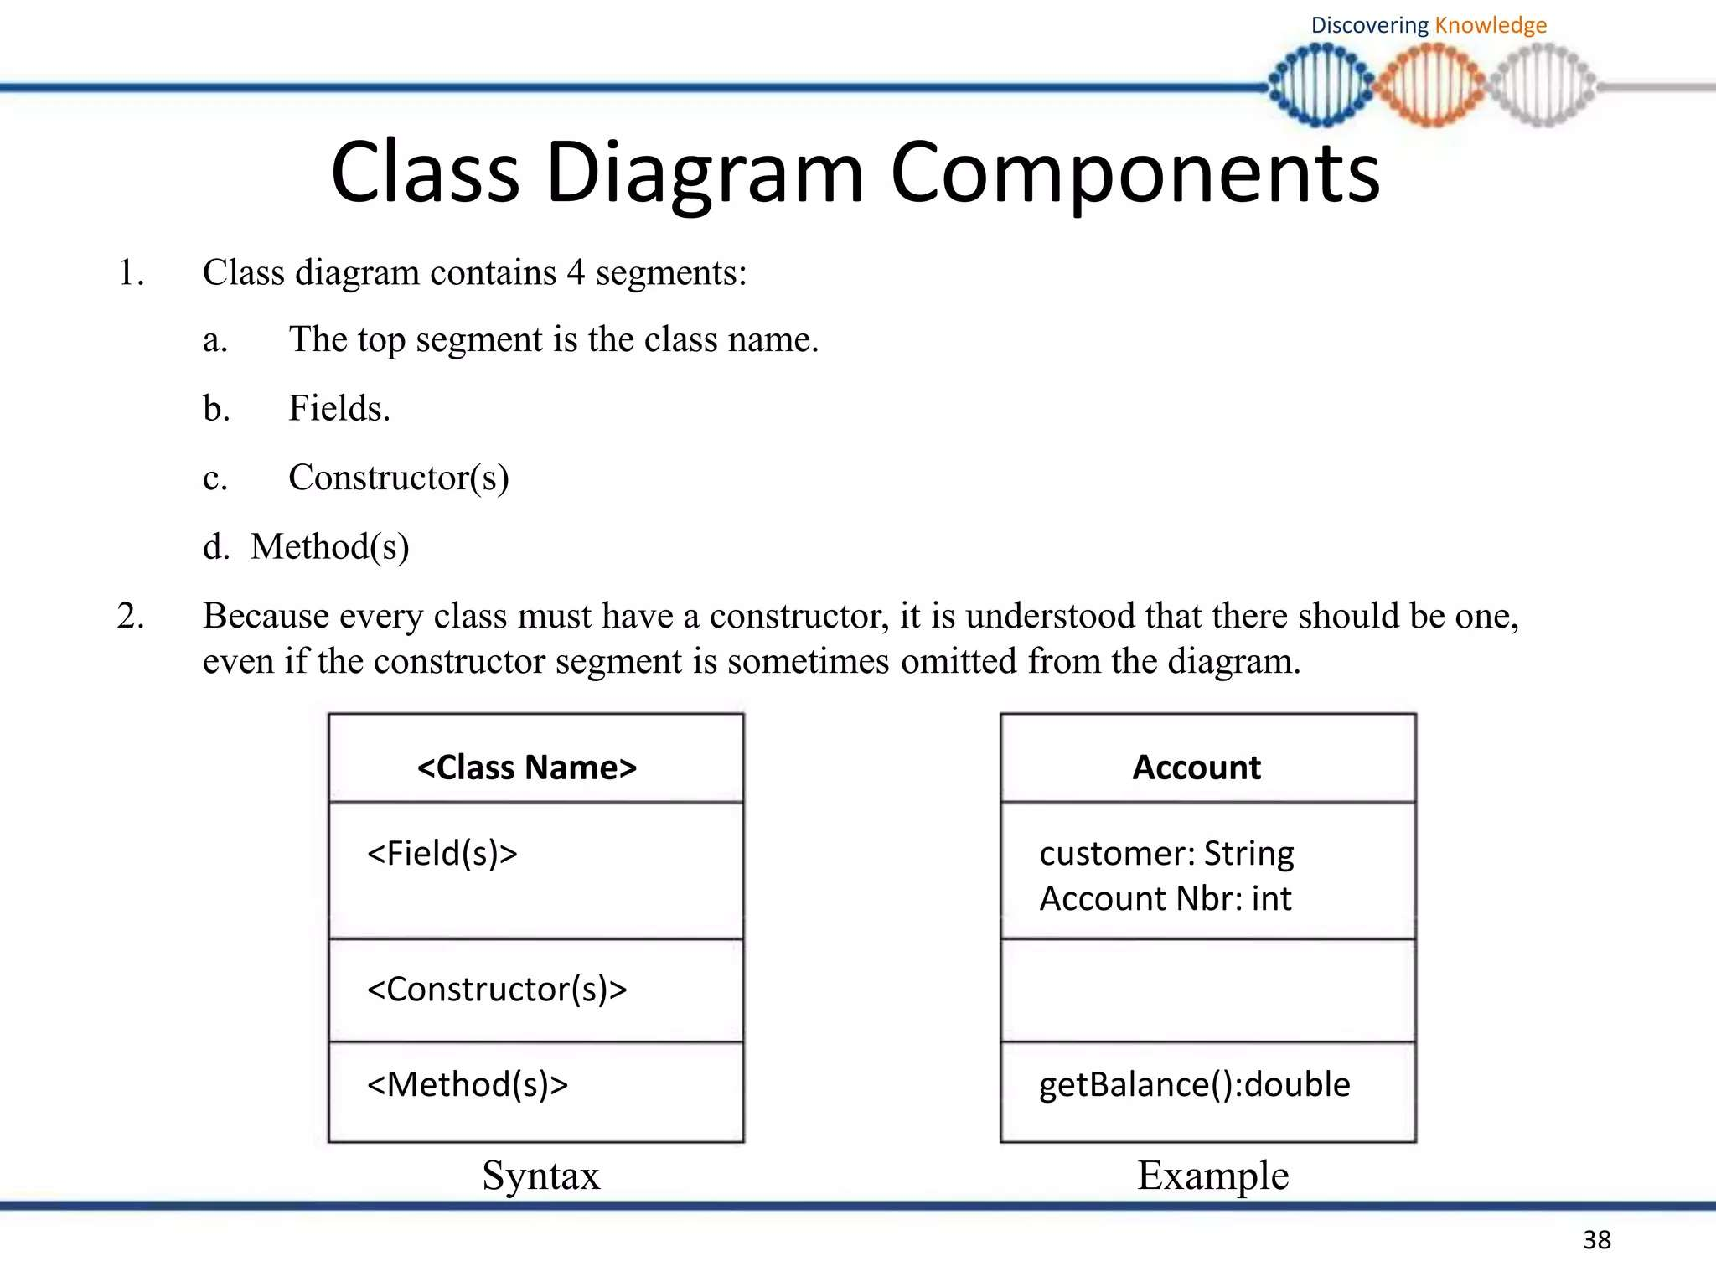

Slide 30
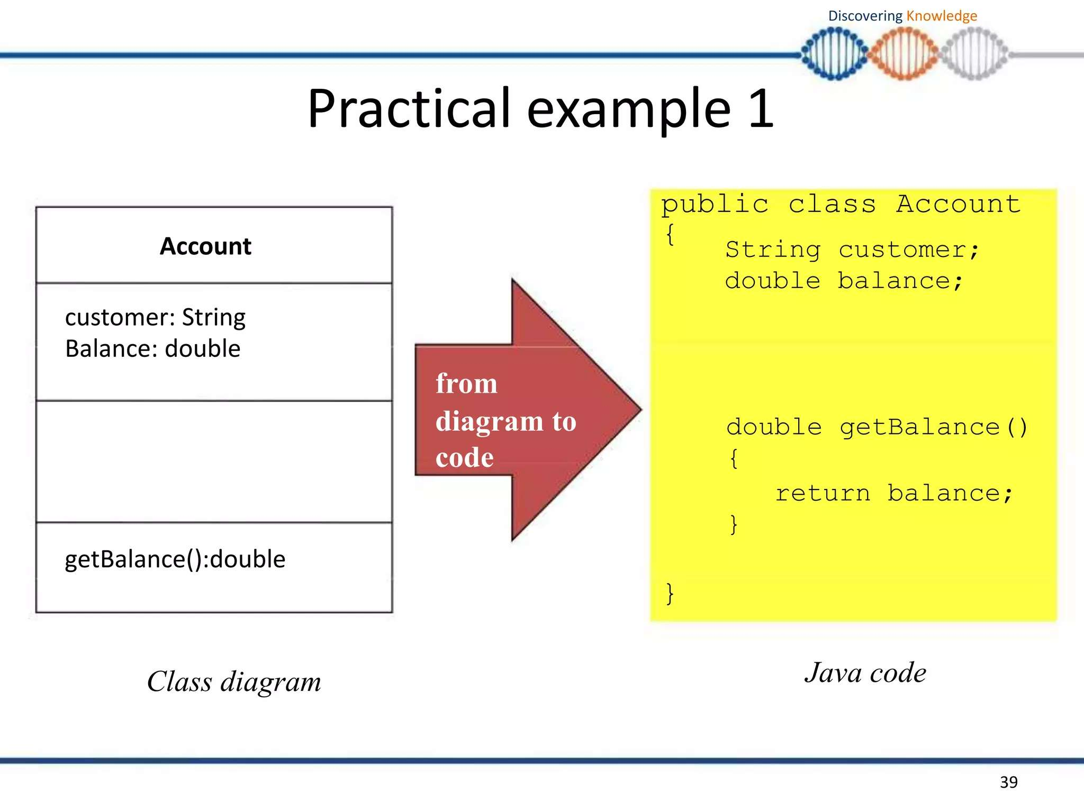

Slide 31
